Slide 1


Department of Electrical and Electronics Engineering Final Year (2020-2024) Batch - VIII Semester
18EEP401L-Project Phase II
Final Viva Voce
Date: 17.05.2024
EMPOWERING EFFICIENCY : A HOLISTIC APPROACH TO ENERGY MANAGEMENT IN INTER-CONNECTED MULTI-SMART BUILDINGS
Guided by:
Team members:
Dharinisri P S (20BEE4012)
Dharshini R (20BEE4013)
Monika P (20BEE4049)
Monika S (20BEE4050)
Mr. N.Selvam M.E,
Assistant Professor,
Electrical and Electronics Engineering.

Slide 2

CONTENTS
Abstract
Introduction
Phase I & Phase II Comparison
Proposed System
Simulink Diagram
Block Diagram
Implementation Process
Components and its Specification
Experimental Setup
Conclusion
References

Slide 3

ABSTRACT
The goal of this strategy is to develop intelligent, networked energy systems that can effectively track and manage energy use across a range of settings.
Technology integrations such CT/PT, PIC controller, relay, load current, LCD, and IOT provide real-time data analysis and decision-making to improve energy use.
The key components of this holistic approach, highlighting the benefits of seamless integration, real-time monitoring, and adaptive control strategies. This methodology can drive significant energy savings, enhance occupant comfort, and contribute to a more sustainable future.

Slide 4

INTRODUCTION
In today's rapidly evolving urban landscapes, the concept of smart buildings has emerged as a pivotal solution to the pressing challenges of energy consumption and sustainability.
Empowering Efficiency explores a comprehensive strategy for energy management in the context of inter-connected multi-smart buildings.
By leveraging the power of digital technologies, data analytics, and intelligent automation, this approach seeks to revolutionize the way of design, operate, and maintain modern urban structures.

Slide 5
COMPARISON
Phase I | Phase II
In phase I , the software integration of the project has been completed. | In phase II , the hardware experimental setup has to be completed.
The Matlab simulink model of the project consists of 5 sources namely PV, wind, fuel cells, power grid and diesel power as an additional one. | The hardware consist of 2 sources namely PV and wind. The other sources which accommodates in simulation will be avoided to make the project cost efficient.
In this work, Adaptive Neuro-Fuzzy Inference Systems (ANFIS) has been used to control the entire process. | In this work, PIC16F887 Microcontroller has been used to control the entire process.

Slide 6

PROPOSED SYSTEM
This method uses a PIC16F887 microcontroller to control the entire system. PV and wind power are the main sources, and they work in tandem with the smart structure to distribute electricity to the buildings based on demand.
The PT/CT sensors monitor the voltage and current consumed, and the system's relay trips in response to the energy demand, ensuring a fault-free, efficient supply of power to all loads.
To indicate the state of the energy supply in a specific building, an LED display is installed. By timing the energy supply in a unique method, the project's efficiency is increased.
Building managers may discover and address inefficiencies with this approach, which reduces environmental impact and costs significantly. Real-time monitoring, advanced analytics, and intelligent control systems are used.

Slide 7
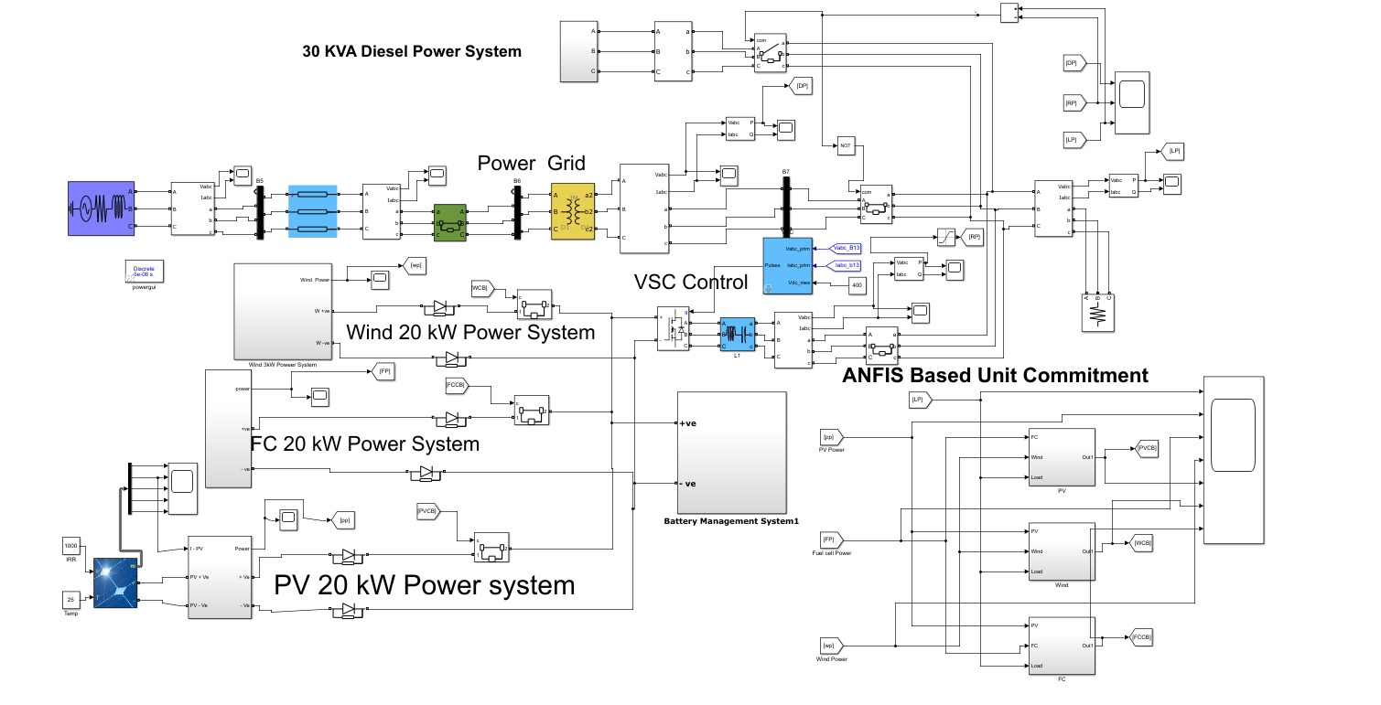
SIMULINK DIAGRAM

Slide 8
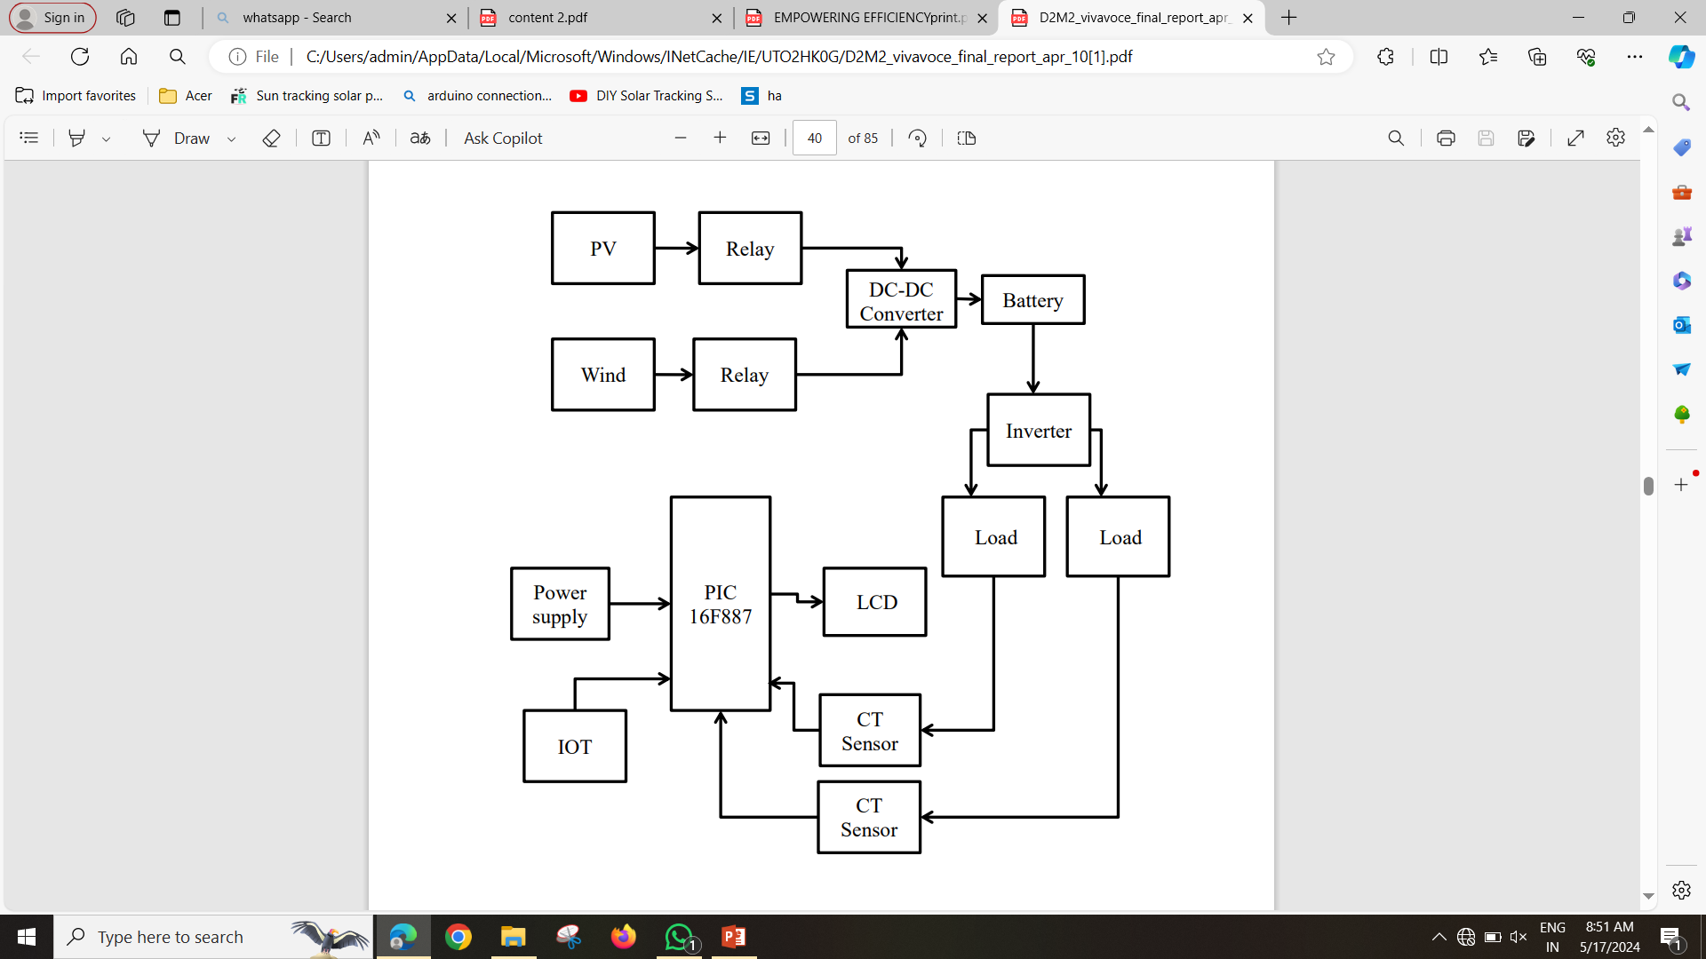
BLOCK DIAGRAM

Slide 9
IMPLEMENTATION PROCESS
CT/PT Device Installation
Data Collection and Processing
Interaction with Relay and Load Current Devices
Analyzing and Optimizing Energy Use
Energy Waste or Malfunction Detection

Slide 10
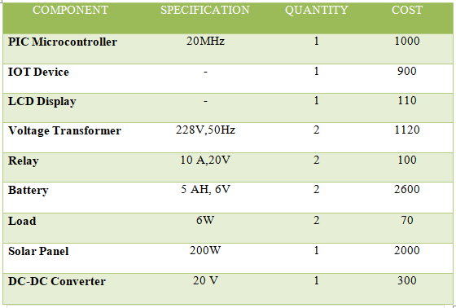
COMPONENTS AND ITS SECIFICATION

Slide 11
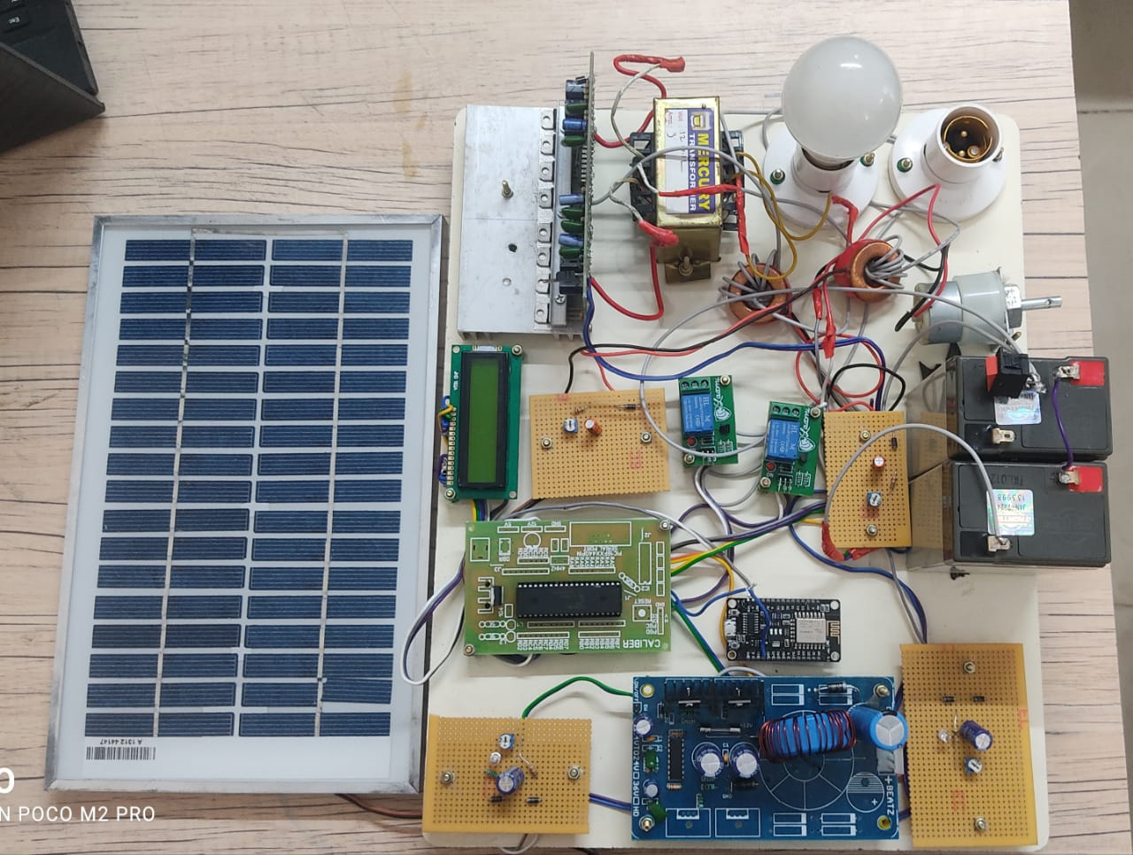
EXPERIMENTAL SETUP

Slide 12
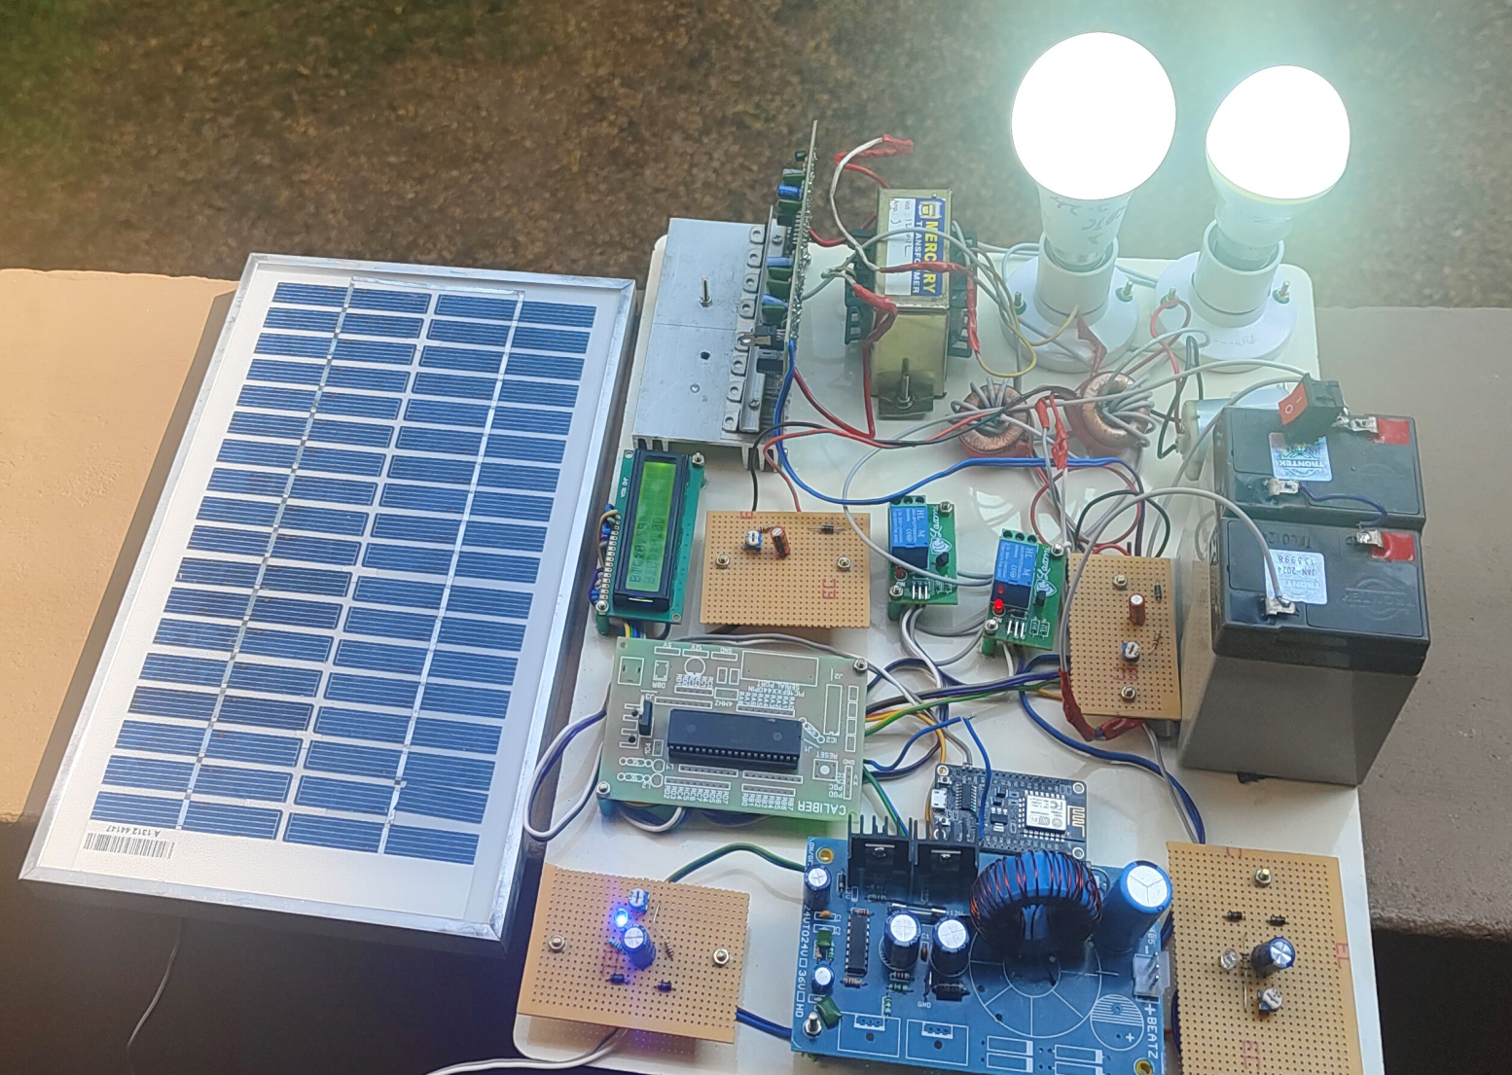
WORKING MODEL

Slide 13
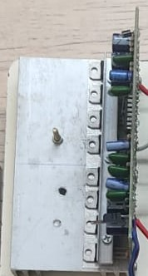
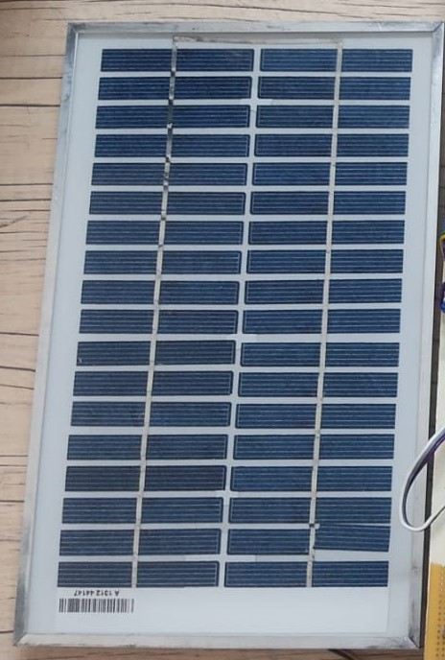

WORKING PROCEDURE
SOLAR PANNEL MOTOR AS WIND SOURCE DC – DC CONVERTER
In this project , two renewable sources are implemented to generate power. PV and Solar power are the sources which accommodate in this system to provide continuous sup ply to the buildings.
PV source generate 10 Watts, 12V and Wind generates 12V.This generated power is given to DC-DC converter to boost the voltage.

Slide 14
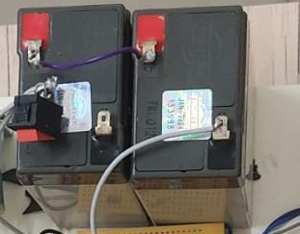
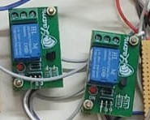
WORKING PROCEDURE
LEAD ACID BATTERY RELAY
The DC voltage from the converter is stored in the Lead Acid Battery which specifies 5AH .This DC power is converted to AC by using inverter.
This Ac power is provided to the buildings according to their demand. The relay in this system acts as a switch and switchover to the efficient power source.

Slide 15
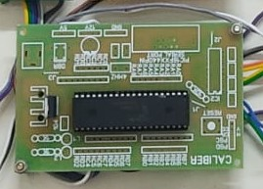
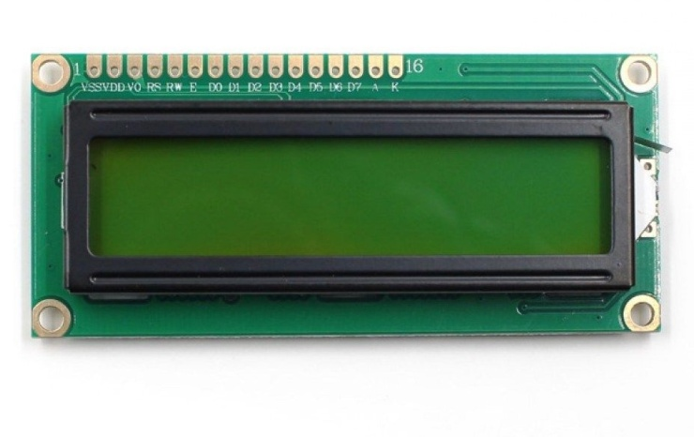

WORK PROCEDURE
16F887 PIC MICROCONTROLLER WI-FI MODULE LCD DISPLAY
The whole system is controlled by PIC 16F887 microcontroller which helps in parallelizing the power to the buildings according to their demand.
In this system, IOT is integrated for real time monitoring of the data's and it is stored in the server. A wi-fi module is connected to share the data of current , voltage generated and supplied to the load.
A LCD display indicates the status of the voltage ,current produced in the sources and used up by the loads. It also indicate the most efficient source to supply the power.

Slide 16
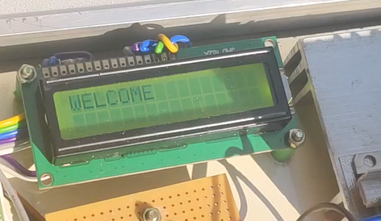
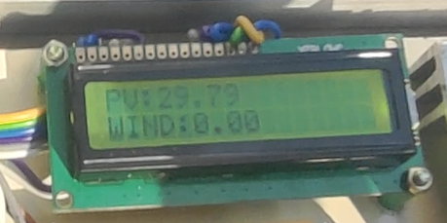
RESULTS AND DISCUSSION
The above display indicates the voltage produced in the PV and Wind source.
PV source generates 29.79 W through solar energy and the wind source is inactive.

Slide 17
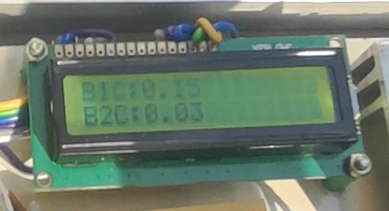
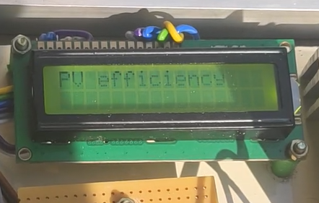
RESULTS AND DISCUSSION
The above LCD display indicate the current drawn by the loads. The building 1 (i.e) load 1 draws 0.13 A and building 2 (i.e) load 2 draws 0.03 A current.
It also indicate the most efficient source at that period of time.

Slide 18

CONCLUSION
Adopting a holistic approach to energy management in interconnected multi-smart buildings is essential for empowering efficiency.
By integrating technologies, data analytics, and user engagement strategies, these buildings can significantly reduce energy consumption, lower costs, and minimize environmental impact.
Embracing this holistic approach not only enhances operational efficiency but also contributes to a sustainable future.
It is imperative for stake holders to collaborate, innovate, and implement these strategies to create smart, energy-efficient buildings that are resilient and responsive to the evolving needs of society.

Slide 19
CONCLUSION
By leveraging advanced technologies and real-time data, this approach offers significant benefits such as reduced costs, reliable energy supply, and a reduced carbon footprint.
With its potential to promote renewable energy, stabilize the power grid, and enable smarter and more efficient energy management, this concept is crucial in addressing the challenges of growing energy demand and climate change.
However, to fully realize its potential, it is essential to address challenges related to cost, interoperability, and data security. Ultimately, Revolutionizing Energy Management is a key step towards creating a greener and more sustainable world for generations to come.

Slide 20
REFERENCES
U.S. Energy Information Administration. (2018). Annual Energy Outlook 2023.
80% Energy Consumed by Buildings—News | Khaleej Times. Accessed: Sep. 27, 2022.
Z. Pooranian, J. Abawajy, V. P and M. Conti, "Scheduling distributed energy resource operation and daily power consumption for a smart building to optimize economic and environmental parameters", Energies, vol. 11, no. 6, pp. 1348, May 2022.
A. Barbato, A. Capone, G. Carello, M. Delfanti, M. Merlo and A. Zaminga, "House energy demand optimization in single and multi-user scenarios", Proc. IEEE Int. Conf. Smart Grid Commun. (SmartGridComm), pp. 345-350, Oct. 2022.
P. Palensky and D. Dietrich, "Demand side management: Demand response intelligent energy systems and smart loads", IEEE Trans. Ind. Informat., vol. 7, no. 3, pp. 381-388, Aug. 2022.

Slide 21
REFERENCES
B. R. Sathyanarayana and G. T. Heydt, "A roadmap for distribution energy management via multiobjective optimization", Proc. Power Energy Soc. Gen. Meeting, pp. 1-8, 2010. 80% Energy Consumed by Buildings—News Khaleej Times. Accessed: Sep. 27, 2022.
R. V. Rao, "Jaya: A simple and new optimization algorithm for solving constrained and unconstrained optimization problems", Int. J. Ind. Eng. Comput., vol. 7, no. 1, pp. 19-34, 2020.
Saeid Fatemi, Abbas Ketabi, Seyed Amir Mansouri, "A multi-level multi-objective strategy for eco-environmental management of electricity market among micro-grids under high penetration of smart homes, plug-in electric vehicles and energy storage devices", Journal of Energy Storage, vol.67, pp.107632, 2023.
D. Pudjianto, G. Strbac, F. van Overbeeke, A. I. Androutsos, Z. Larrabe and J. T. Saraiva, "Investigation of regulatorycommercial economic and environmental issues in microgrids", Proc. Int. Conf. Future Power Syst., pp. 1-6, 2019-Nov.

Slide 22
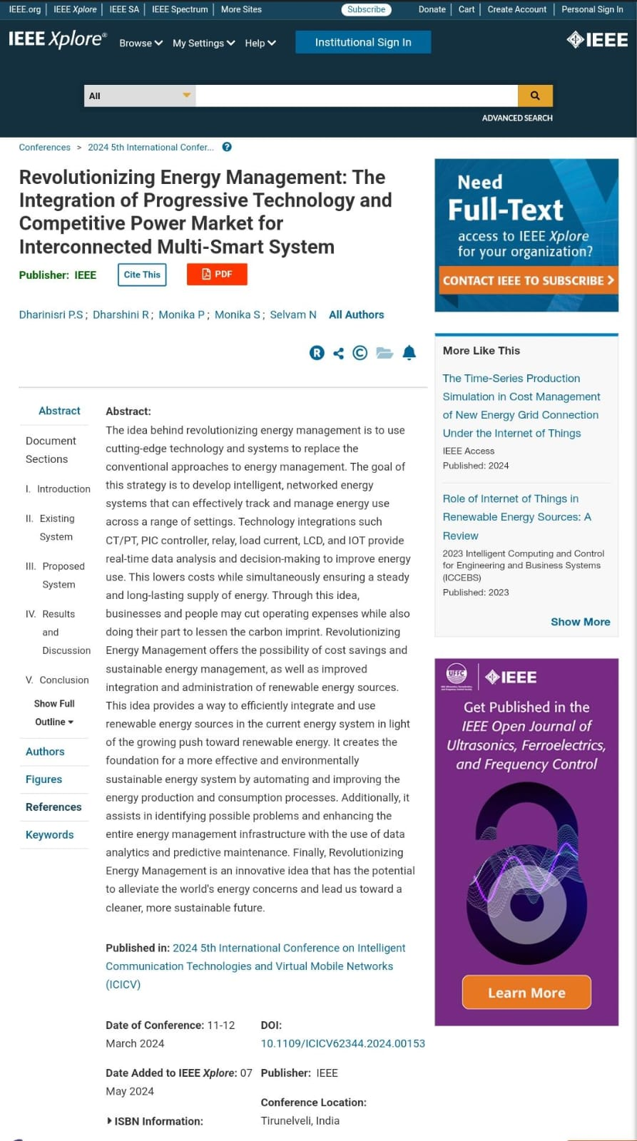
PUBLICATION

Slide 23


